Slide 1
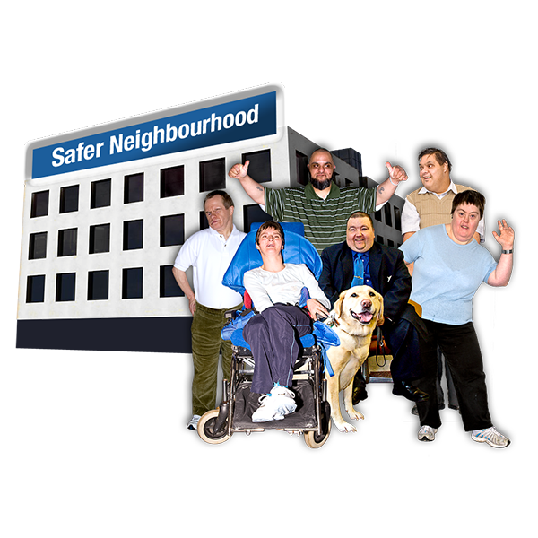
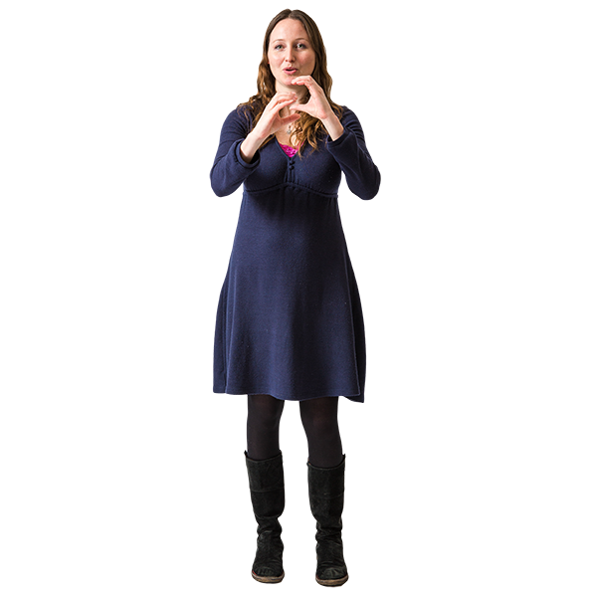
Tell us what you think about feeling safe in the Causeway Coast and Glens area if you have a Disability
Causeway Coast and Glens Policing and Community Safety Partnership (PCSP) wants to make sure that everyone feels safe on their community
We want to know what makes people with disabilities feel safe or unsafe in their community
We want to know how we can help people feel safe in your home or community
You can tell us what you think by answering:
one of our easy read questionnaires OR one of our online questionnaires
Let us know if you need help to fill in the questionnaire.
You can contact us by:
Email pcsp@causewaycoastandglens.gov.uk
Phone or Text 07511046188
Sign video
https://www.causewaycoastandglens.gov.uk/signvideo

