Slide 1
Eoin McGahon
Technical Specialist

Slide 2
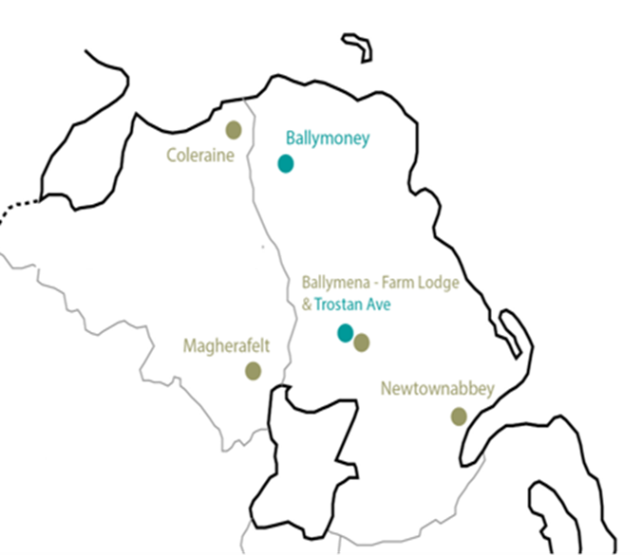
Support at NRC
At Northern Regional College we support the economy by providing a wide range of services to the business community including consultancy, training and upskilling.
Business Engagement Officers
Dedicated Technical Specialists
Industry Experienced Lecturing Staff

Slide 3
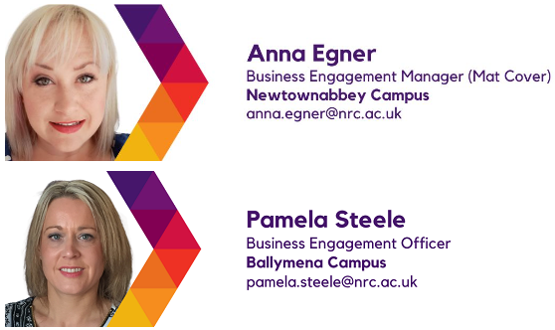
Business Engagement Team

Slide 4
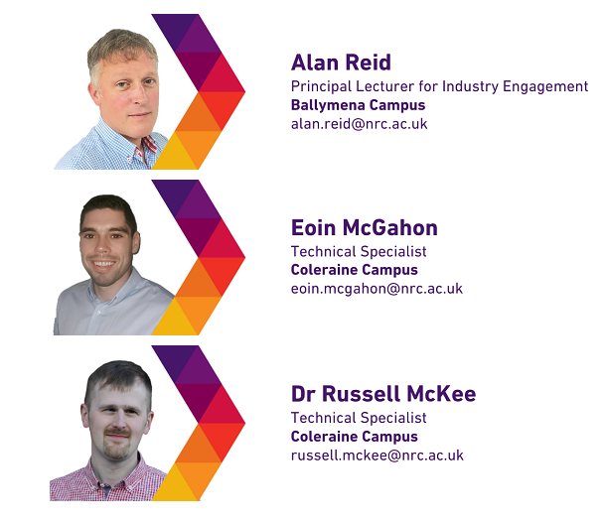
Innovation Team

Slide 5
Developing skills
Upskilling and Reskilling
Notes:
We have a number of programmes designed to upskill and develop our industry workforce.

Slide 6
Areas of Support
Product Design
Prototyping & Testing
Manufacturing Processes
Robotics & Industry 4.0
Sustainability
Green Tech & Hydrogen
Construction & Surveying
Business Mentoring
Leadership & Management
Marketing & e-Commerce
IT & Business System Integration
Making use of AI
Health & Social Care
Food Labelling & Packaging
Notes:
At Northern Regional College as at NWRC we support the economy by providing a wide range of services to the business community including consultancy, training and upskilling.

Slide 7
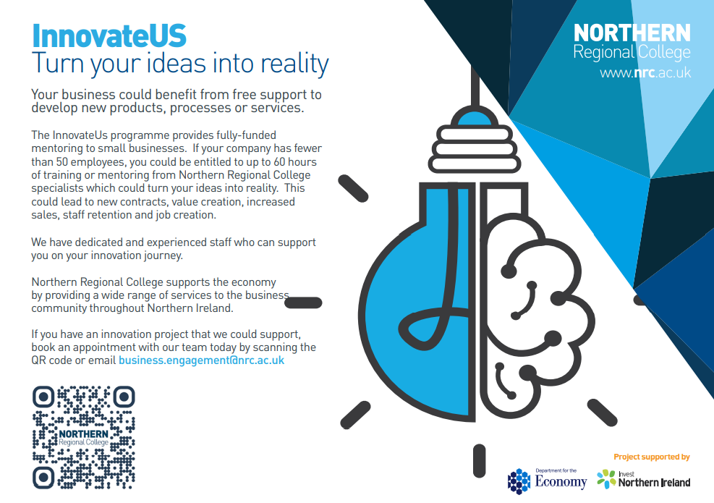
Notes:
Describe InnovateUS and give example

Slide 8
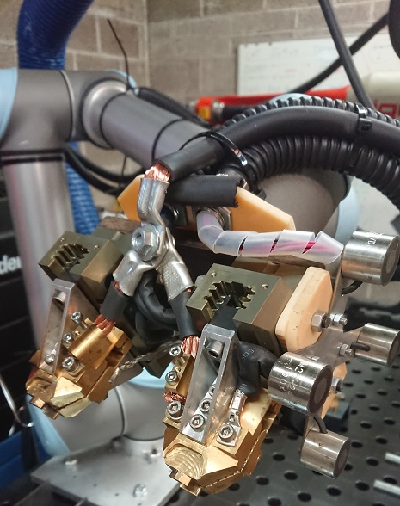
Connected NI
Funded by Department for the Economy
Knowledge exchange programme
Bring expertise to local business
Provide access to world class facilities
Available to companies of all sizes

Slide 9
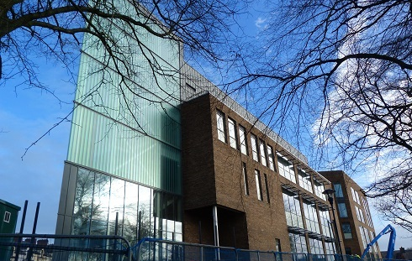
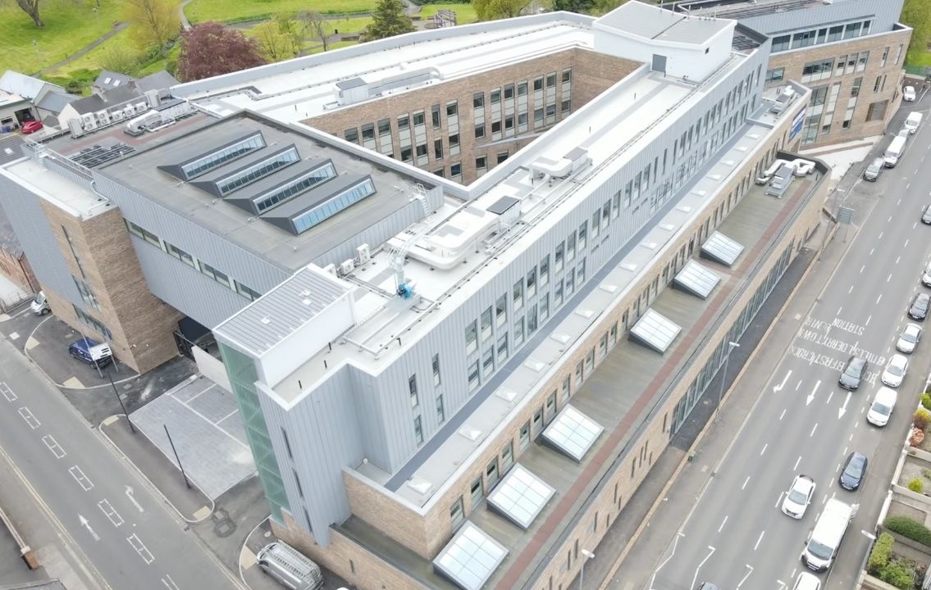
New Causeway Campus Welcoming Industry & Students from Sept 24
12,600 m² campus
Exciting and innovative new space for working and learning.
Industry-leading equipment and facilities to support and enhance curriculum delivery
Notes:
We are very excited to be moving into our new, purpose-built Causeway campus on the 1st August! It is situated on the current (but extended) site on Union Street, in Coleraine. Entrance to the main building will be via Union Street and Anderson Park, with the open airy ‘garden room’ extending the park space into the building. This campus replaces both Ballymoney and the temporary Beresford Ave Campus.
The former St Patrick’s Church of Ireland Hall will be a self-contained performing arts and music centre, incorporating Music Rooms’ Recording Studio; Box Office and Dressing Rooms.
As well as state of the art classrooms, It suites, training suites and laboratories, we have incorporated an:
Animal Management Area
Hair and Beauty Salons (Open to the Public from late Autumn)
Training Restaurant (Open to the Public initially as a coffee shop and as a fine dining experience from late Autumn)
TV Studio and Control Room
Innovation Zone and Central Hall
Sports Hall
Fitness Suite
Bookable Meeting rooms

Slide 10
Let’s Do Business
https://www.nrc.ac.uk/businesses/meet-the-team

